Slide 1
Data Centric RAD
Bachelor of Science (Honours) in Computing in Software Development
Bachelor of Science in Computing in Software
Development
Department of Computer Science & Applied Physics

Slide 2
JSF & ManagedBeans
A ManagedBean is normal Java Class.
It is used to hold form data.
The ManagedBean (Java Class) is created and managed by JSF – it does not have to be created by your code.

Slide 3
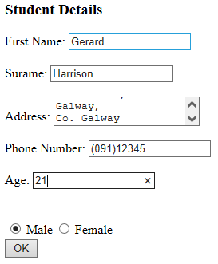
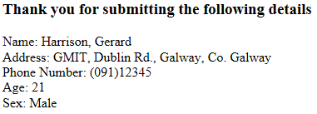
JSF without ManagedBeans
Input.xhtml
Output.xhtml

Slide 4
JSF with ManagedBeans
Input.xhtml
Output.xhtml
ManagedBean
Student

Slide 5
ManagedBean Requirements
Must have a Public no argument Constructor
Must expose properties via Public getter/setter methods
Must have the @ManagedBean annotation (import javax.faces.bean.ManagedBean)

Slide 6
ManagedBean Example
import javax.faces.bean.ManagedBean;
@ManagedBean
public class Student {
private String firstName;
private String surname;
public Student() {
}
public String getSurname() {
return surname;
}
public void setFirstName(String firstName) {
this.firstName = firstName;
}
public String getSurname() {
return surname;
}
public void setSurname(String surname) {
this.surname = surname;
}
}
@ManagedBean annotation
Public no argument
Constructor
Public getters/setters

Slide 7
Reading data from a ManagedBean
Previously we saw how to bind data to a variable:
#{variable}
This will either read the value of variable or if used in an input element, set the value of variable:
<h:inputText value="#{firstName}"

Slide 8
Reading data from a ManagedBean
A similar syntax is used to get data or set data in a ManagedBean:
Name is: #{student.firstName}
This will automatically call Student.getFirstName() and display the return value.
Enter Name: <h:inputText value="#{student.firstName}"
This will automatically call Student.setFirstName(name) with whatever was entered in the input field.

Slide 9
Displaying a ManagedBean property
Name is: #{student.firstName}
public class Student {
When a ManagedBean property is being displayed, the first letter of the property is capitalised and get inserted before it to get the Class method to call
First letter of the ManagedBean
is the lowercase first letter of Class Name
private String firstName;
public String getFirstName() {
return firstName;
}

Slide 10
Setting a ManagedBean property
<h:inputText value="#{student.firstName}"
public class Student {
When a ManagedBean property is being displayed, the first letter of the property is capitalised and set inserted before it to get the Class method to call
First letter of the ManagedBean
is the lowercase first letter of Class Name
private String firstName;
public String setFirstName(firstName) {
this.firstName = firstName;
}

Slide 11
JSF – ManagedBean Scope
A ManagedBean can have different “scope”.
The most common are scopes are:
Request Scope
Session Scope
Application Scope

Slide 12
Request Scope
In JSF, Request Scope is defined with the @RequestScoped annotation before the class definition.
A new ManagedBean is created for every request.
Commonly used for one time uses e.g. submitting form data.
@RequestScoped is the default scope in JSF.
javax.faces.bean.RequestScoped;

Slide 13
Session Scope
In JSF, Session Scope is defined with the @SessionScoped annotation before the class definition.
The ManagedBean is created for each user’s browser session.
The ManagedBean is unique per user.
Any ManagedBean that deals with a database should have Session Scope
javax.faces.bean.SessionScoped;

Slide 14
Application Scope
In JSF Application Scope is defined with the @ApplicationScoped annotation before the class definition.
The ManagedBean is created once and shared by all users of the application.

Slide 15
Form Validation Messages
h:message tag shows a message for a specific element
Name: <h:inputText value="#{employee.name}"
id = "name"
required="true" requiredMessage="Name is mandatory">
</h:inputText>
<h:message for="name"/>
Error message will be displayed if the input if left blank.

Slide 16
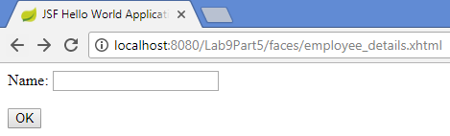
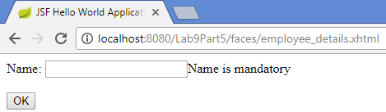
Form Validation Messages

